Slide 1
Limitations of Coding Benchmarks
when linguists try software engineering

Slide 2
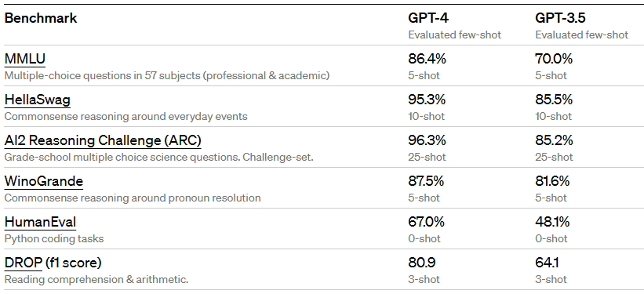
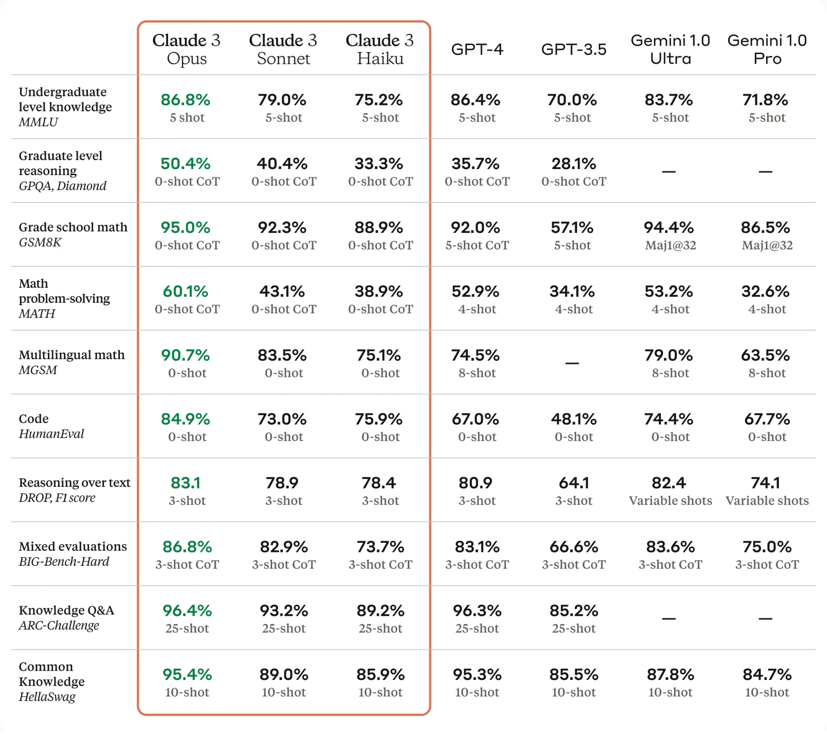
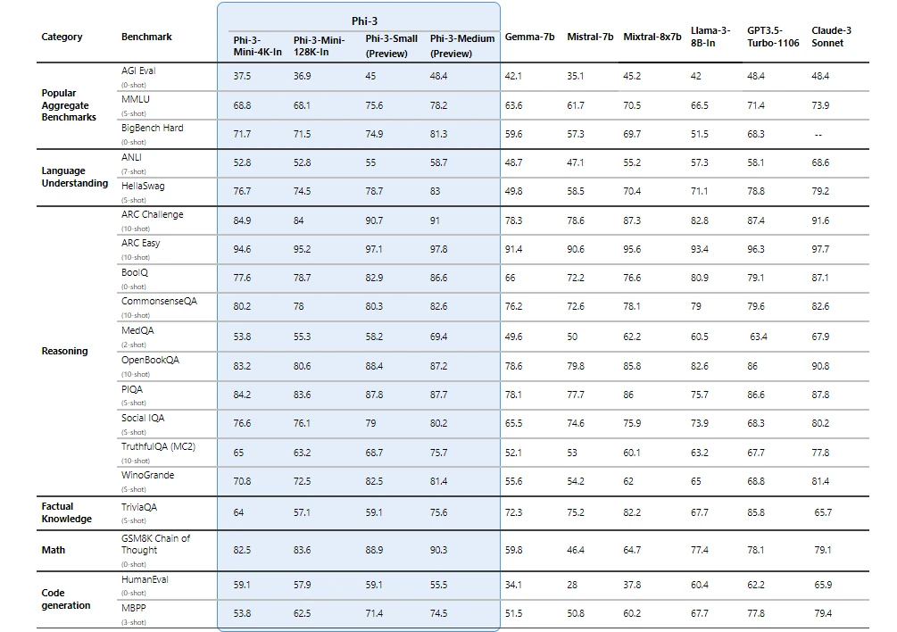
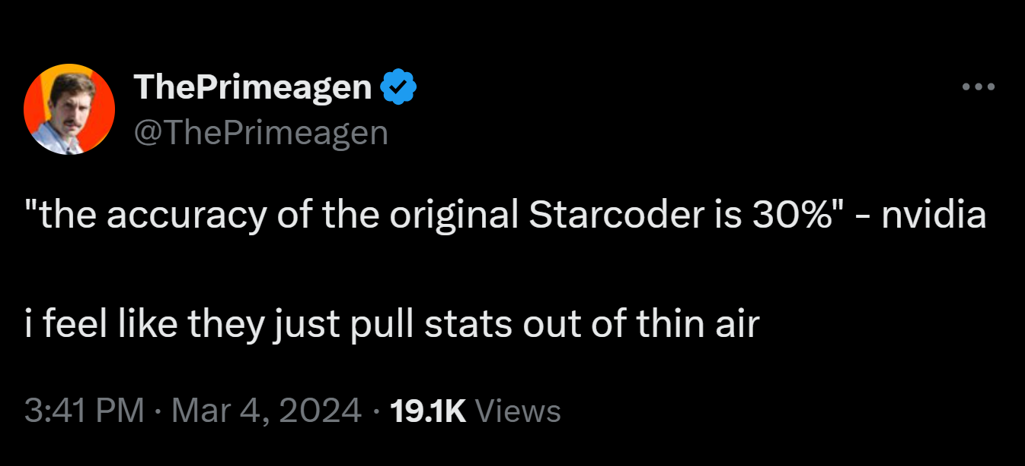
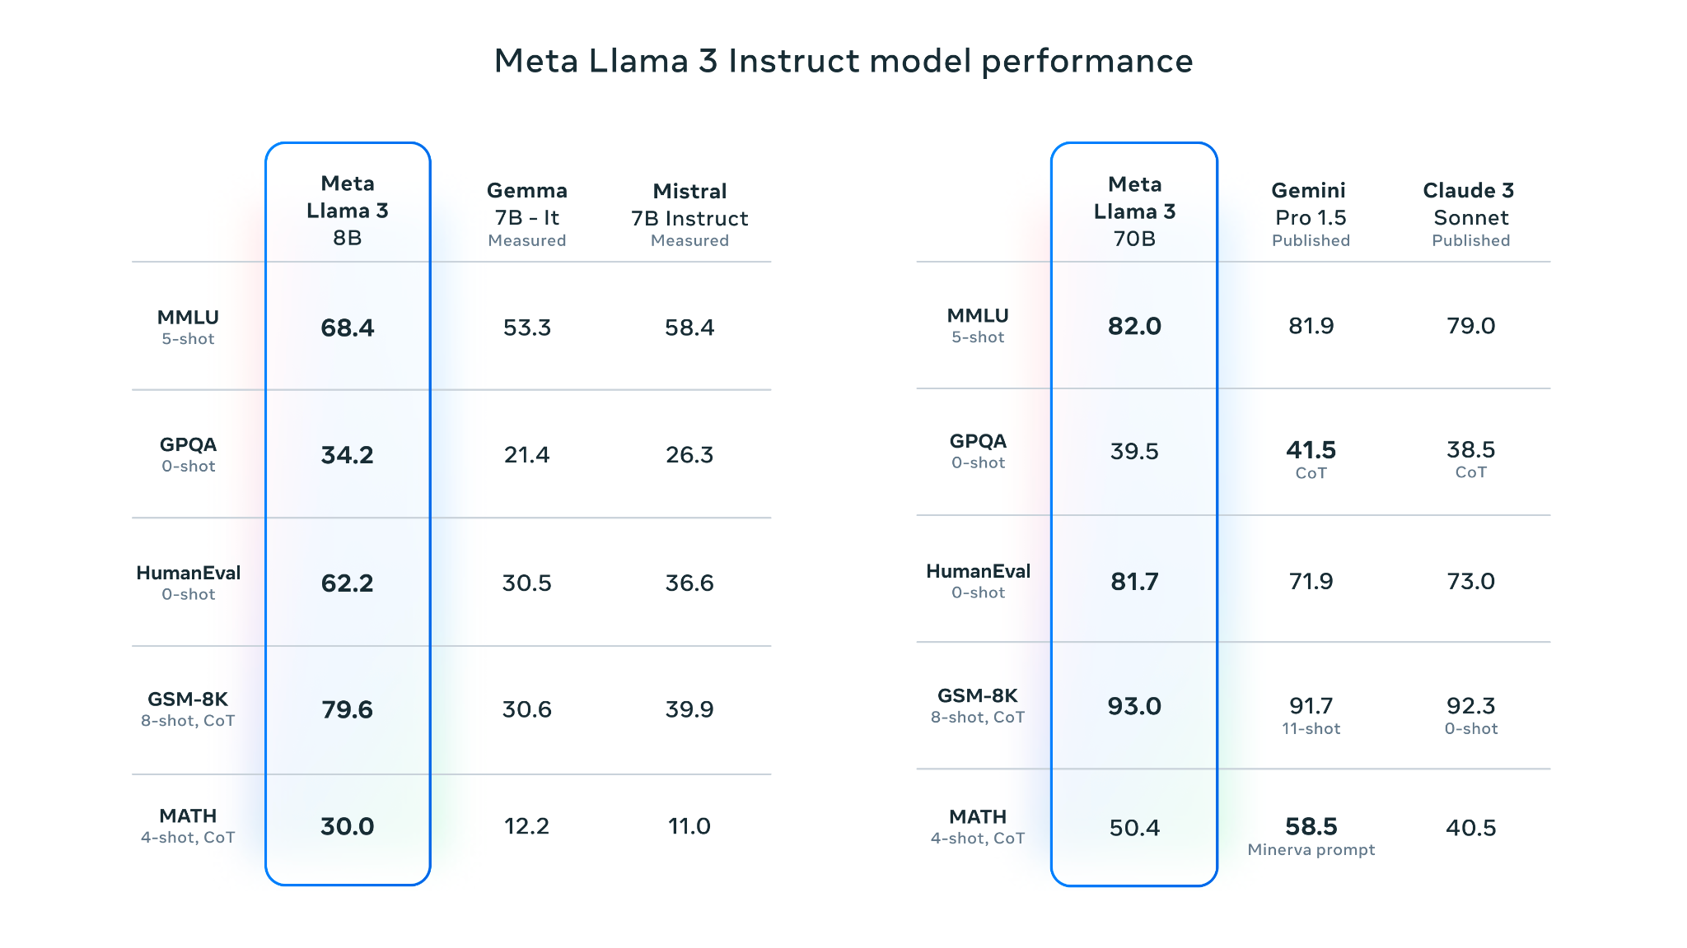
Why are we here?

Slide 3
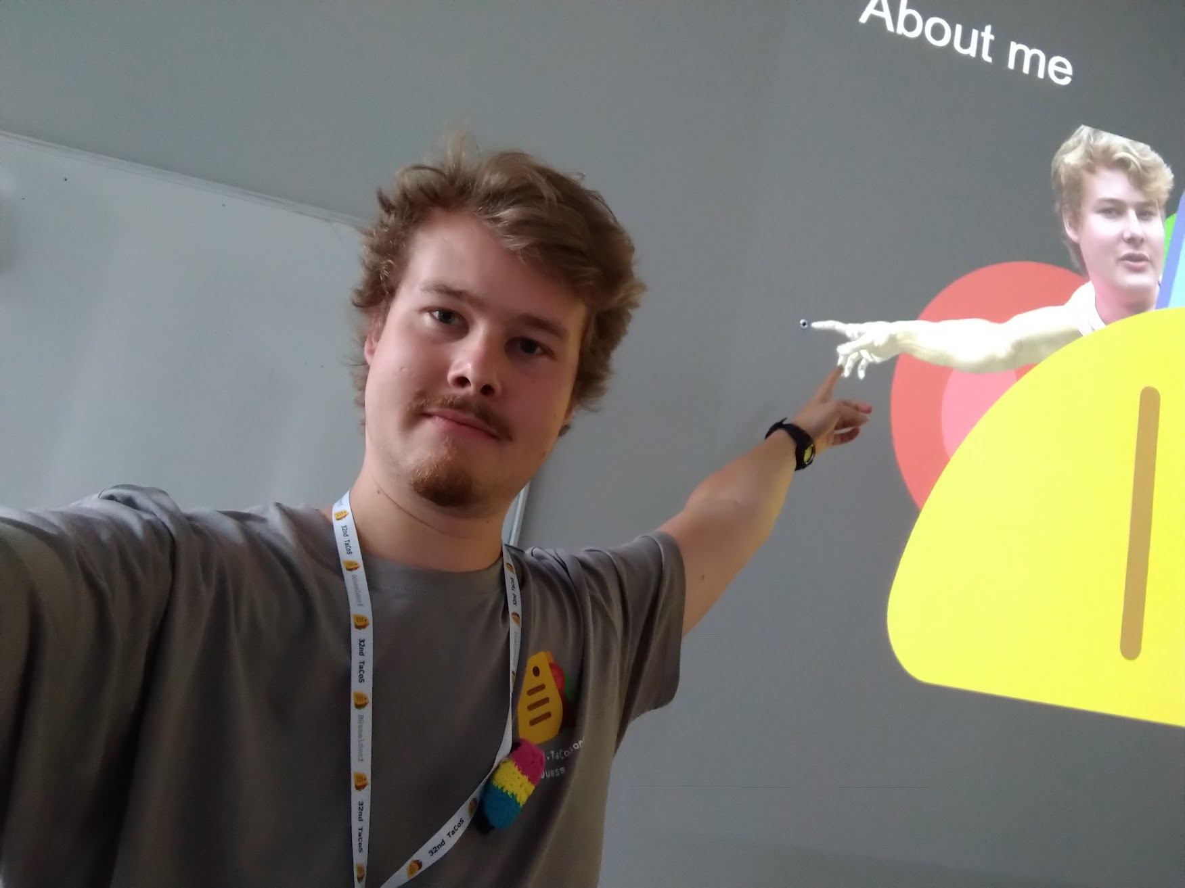


About me ( the recursive slide)
Jan.Kels@hhu.de
BA CL in HHU Düsseldorf!
@Vipitis
Research interest: code generation, computer graphics
Hobbies: Counter-Strike, Thermal Cameras and Chess!
English/German

Slide 4
What is the goal here?
Understand what these numbers mean
Realize there is limitations
Learn about some alternatives
My proposal for creative coding
Discuss

Slide 5
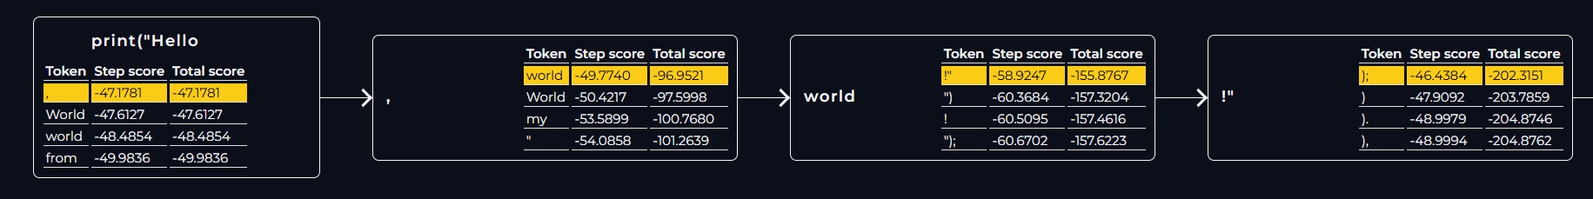
What is language model?
Autocorrect to BERT to Llama3
Assign a probability to every sequence (natural language, code, …)
Not intelligent, not sentient
Autoregressive generation

Slide 6
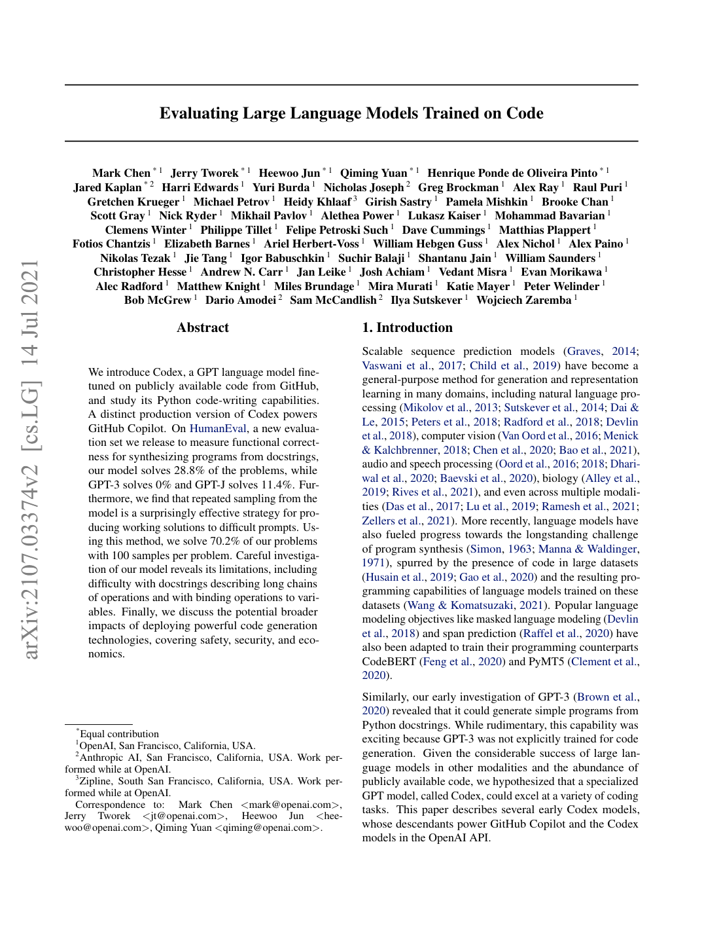
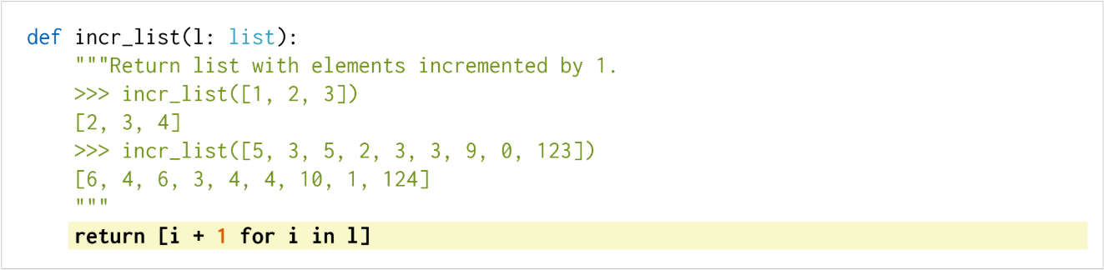
Current SOTA: Code Completion in HumanEval
Given a function name and docstring, model generates the function body
Tests it against unit-tests (known Input, Output)
Report pass@k passing rate, nowadays k=1
164 Problems, all in Python

Slide 7
Some Examples (related work)
MBPP: more problems
MathQA-Python: mathematical problems as coding task
MultiPL-E: more programming languages
DS-1000: Data-Science related problems
Many more, plenty of variants

Slide 8
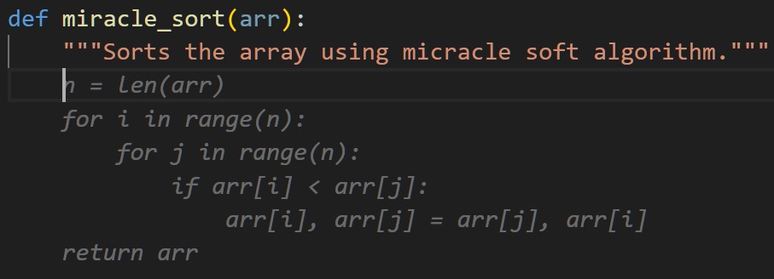
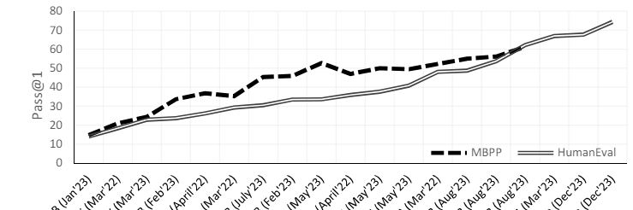
Problems?!
Programming is more than writing easy standalone functions
Data contamination
Sampling strategies, model shift?
Saturation

Slide 9
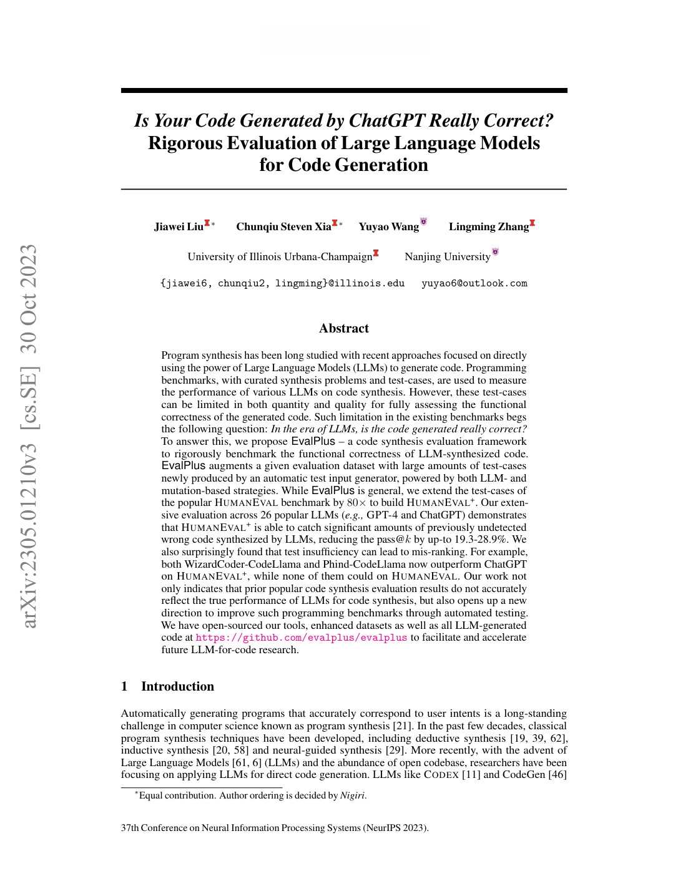
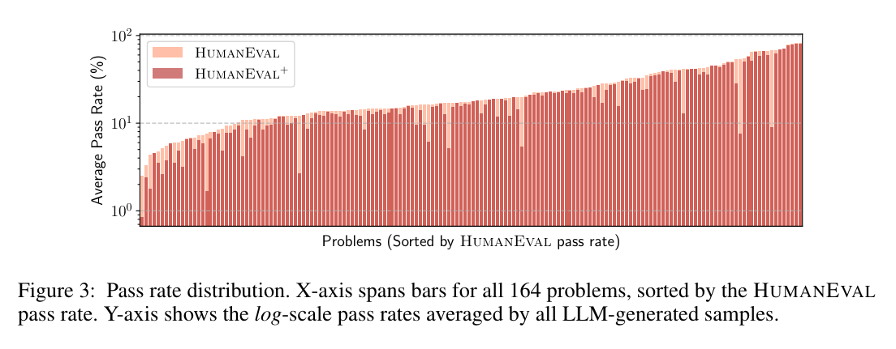
Problem: a scale of difficulty
Easy: “Adding two numbers”, “length of a string”
Hard: “Tribonacci sequence”, “n-th prime Fibonacci number”
LOG SCALE!

Slide 10
A quick look at 2 proposals from the literature

Slide 11
Ideas
Code editing (bugfixing, optimization, documentation: NoFunEval, HumanEvalFix)
Repo scale, like github issues to PR (SWE bench, RepoBench, CrossCodeEval)
Empirical data (TabbyLM leaderboard)

Slide 12
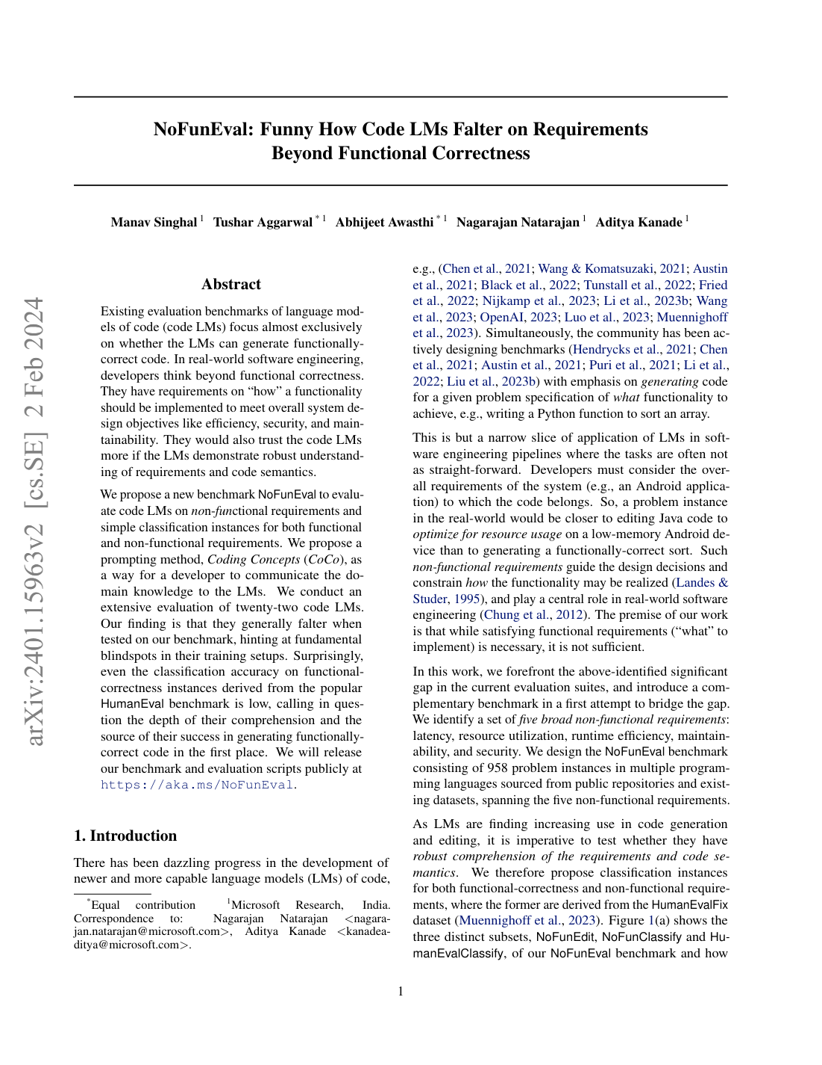
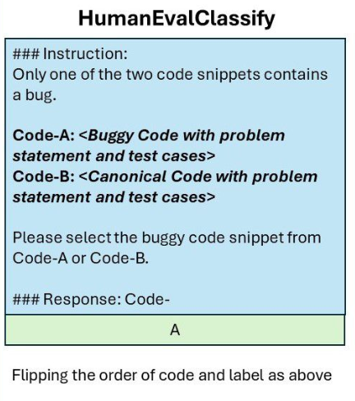
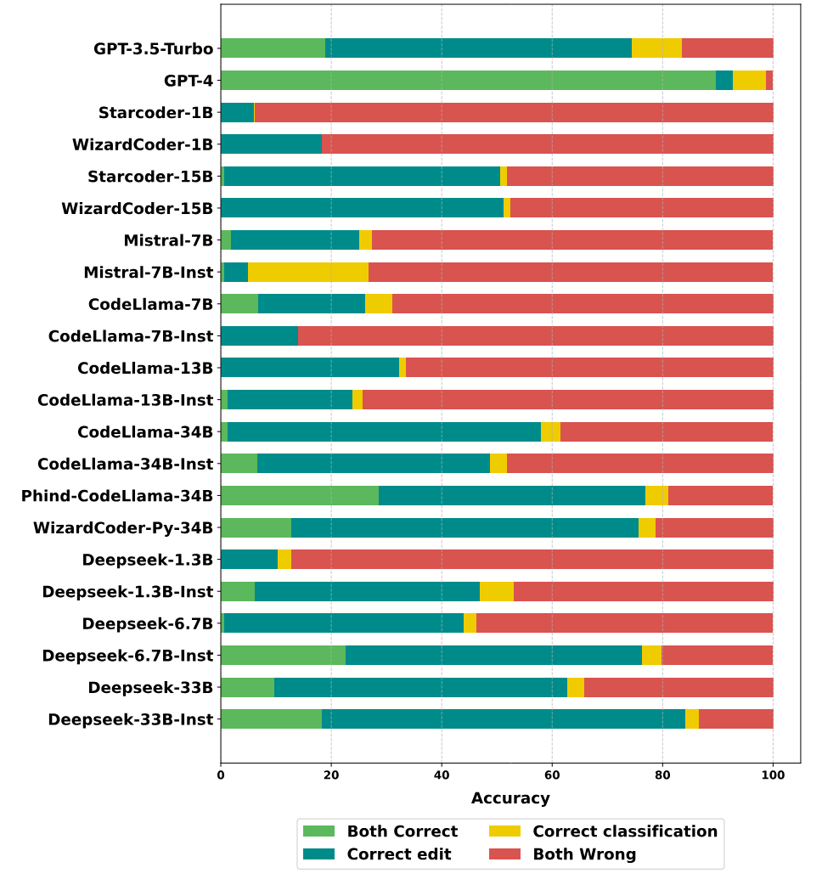
Code Editing and Comprehension
Editing and classification tasks
Bug fixing, optimization, security, maintainability
Most models can edit, but not comprehend!

Slide 13
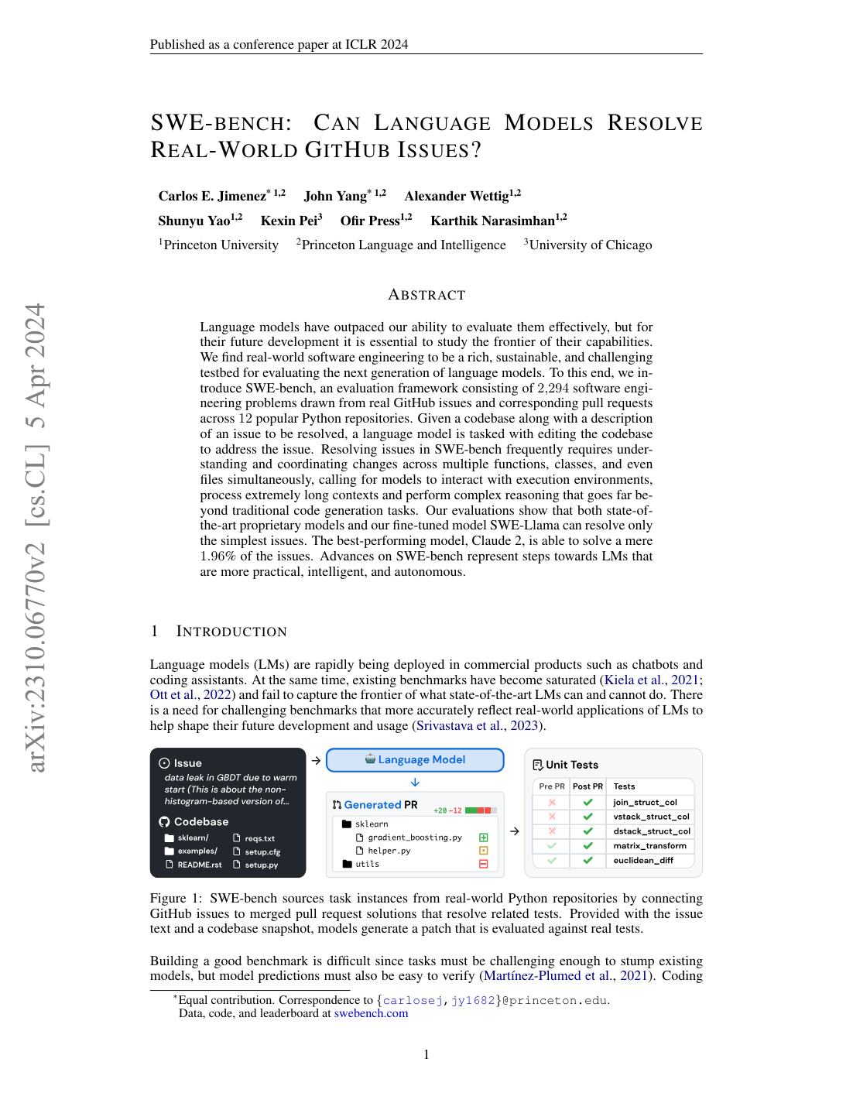
SWE-Bench: Repository level Code changes
Created from real world github issue - PR pairs
Feature Requests or Bug Reports
Requires multiple files, allows retriever systems
Feedback from errors (?)
Submit a .patch, not rewrite the files
Already used in marketing (Devin)
Currently really low scores (max is 12.47%)

Slide 14
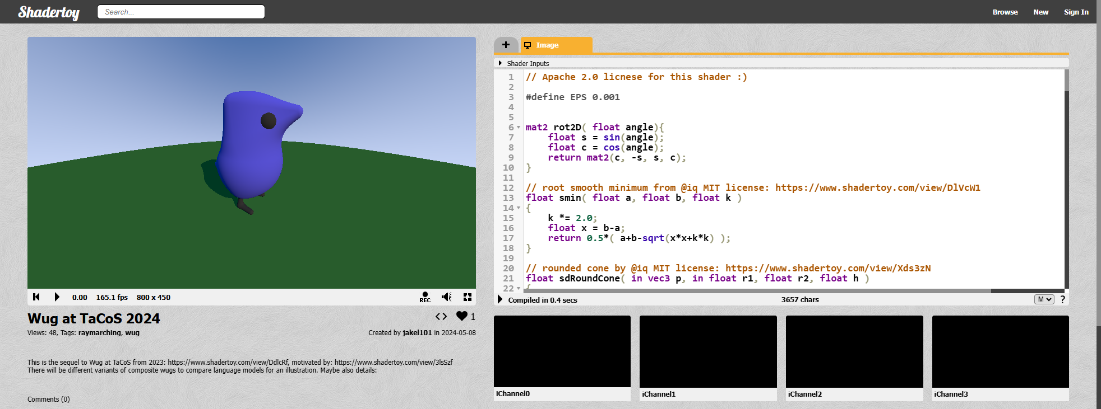
Proposal: coding art!
Live demo: wug sequel https://www.shadertoy.com/view/McVXWW

Slide 15
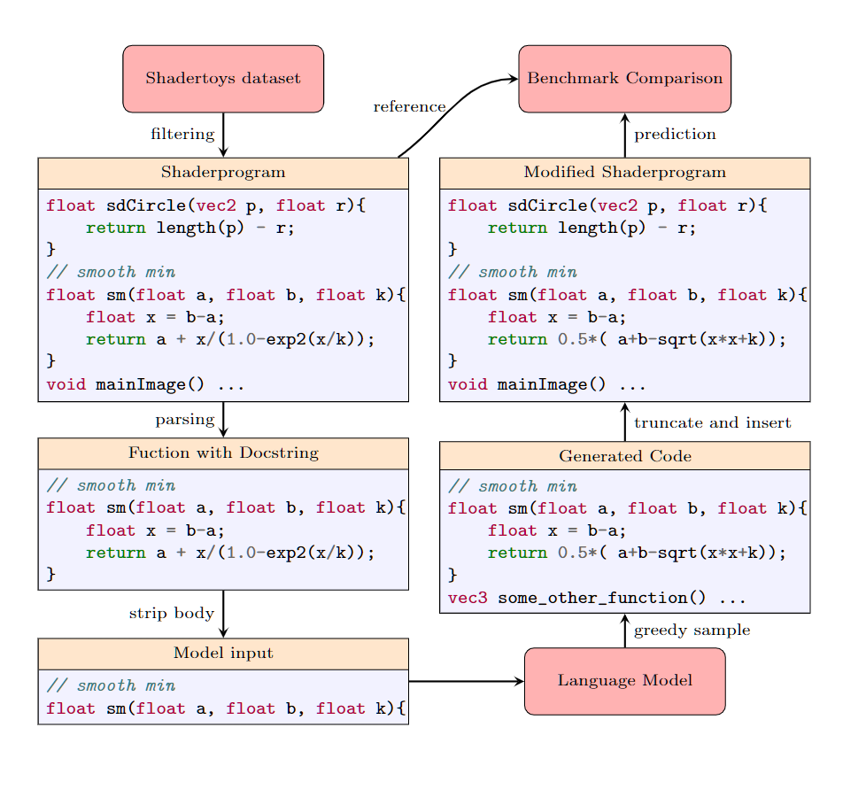
ShaderEval-2: Function Completion
Functions need to be syntactically sound but are semantically free
Instructions from docstrings(kinda)
4 Types of Code Clones
compare the rendered images
Some are “better”, most are “worse”
How does one evaluate “creativity”?
Examples of LLMs trying to do a wug
Copilot, Llama3, Mixtral;

Slide 16
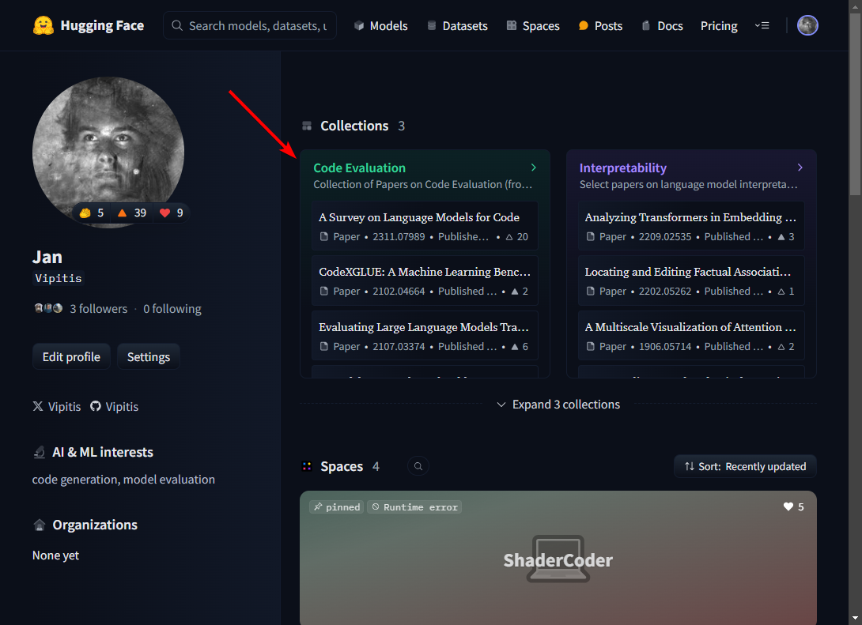
Further Reading
Image references as hyperlinks
Survey paper repository: github.com/codefuse-ai/Awesome-Code-LLM
https://tabby.tabbyml.com/blog/2023/11/13/model-evaluation
My reading list on the topic: hf.co/Vipitis: Code Evaluation

Slide 17
Concluding…
One coding benchmark is widely used: HumanEval
Bigger number better doesn’t indicate real word usability
Various new concepts have been proposed, but not yet adopted
ShaderEval looks at “creative” coding, without a single correct solution!
… more research is needed

Slide 18
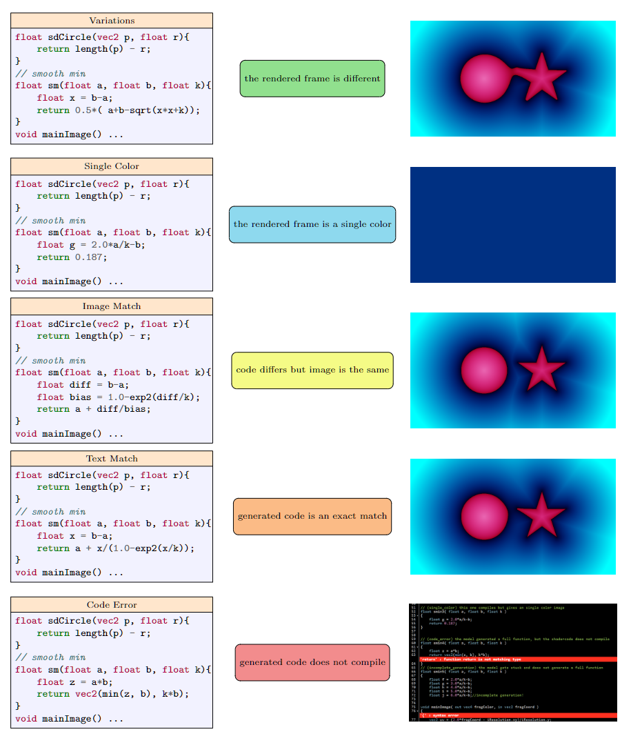
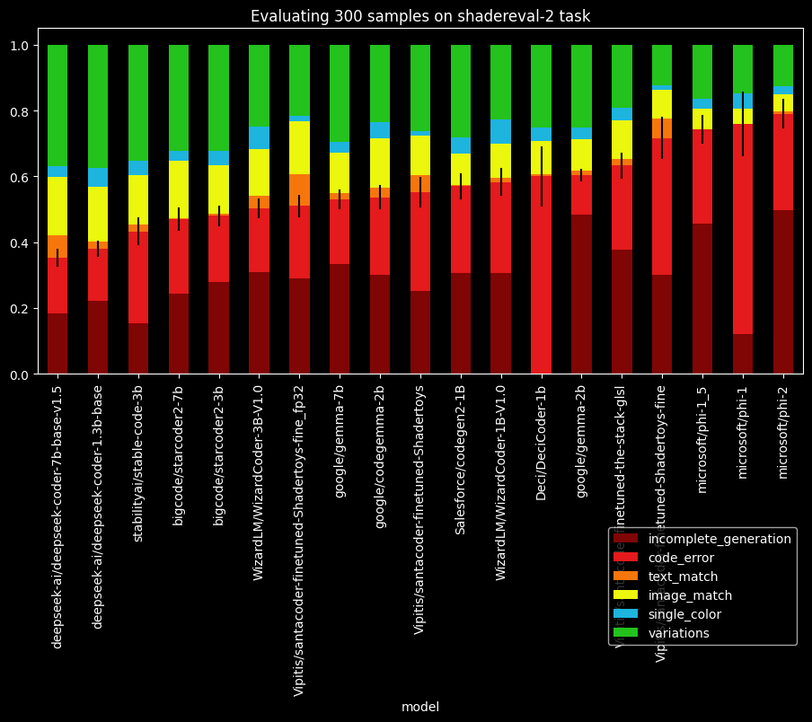
Bonus 0:Metric and first results

Slide 19
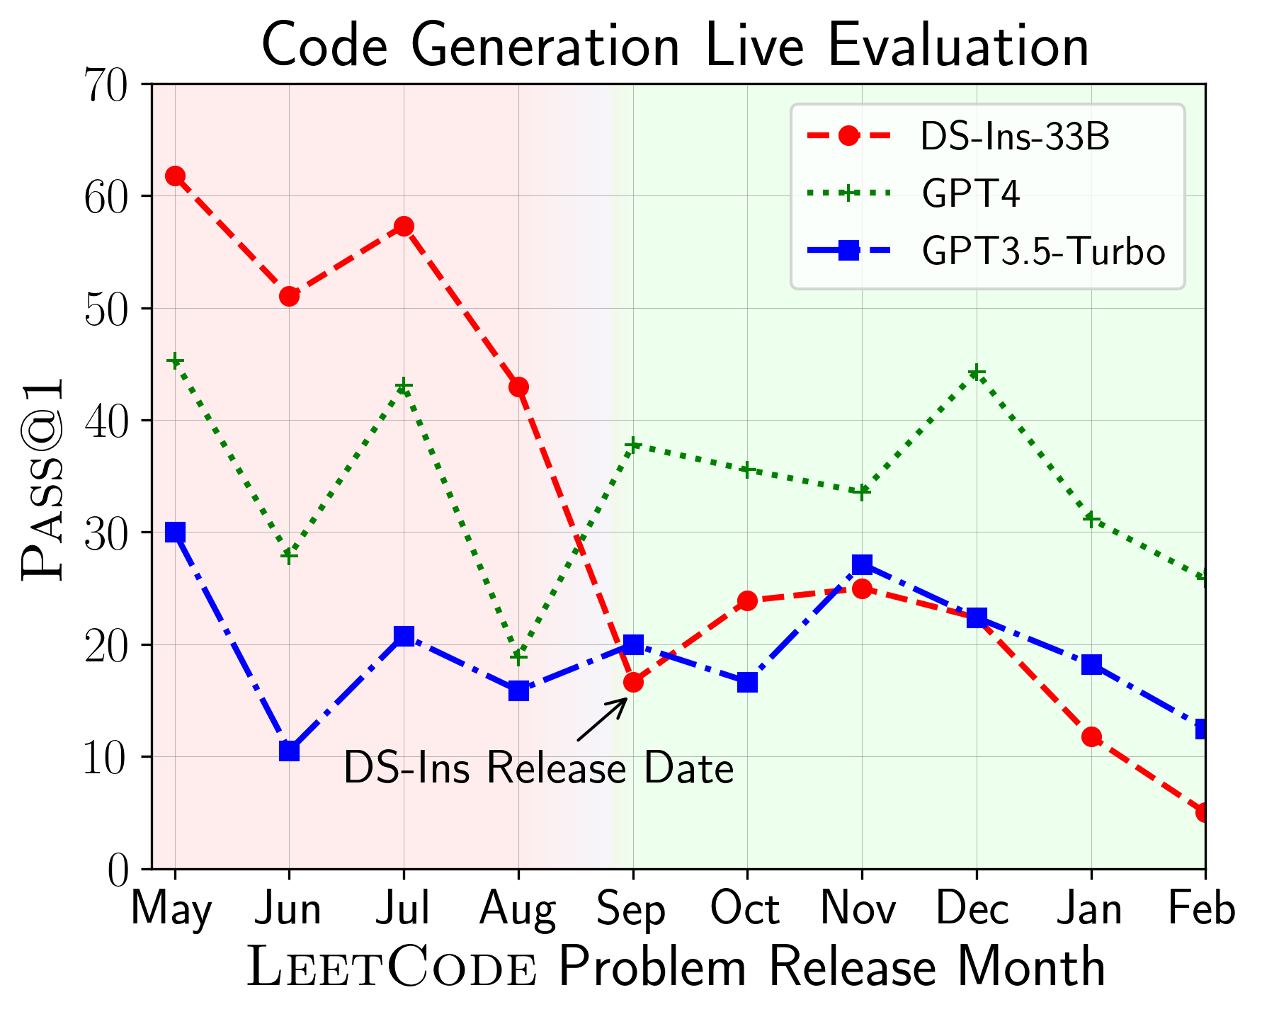
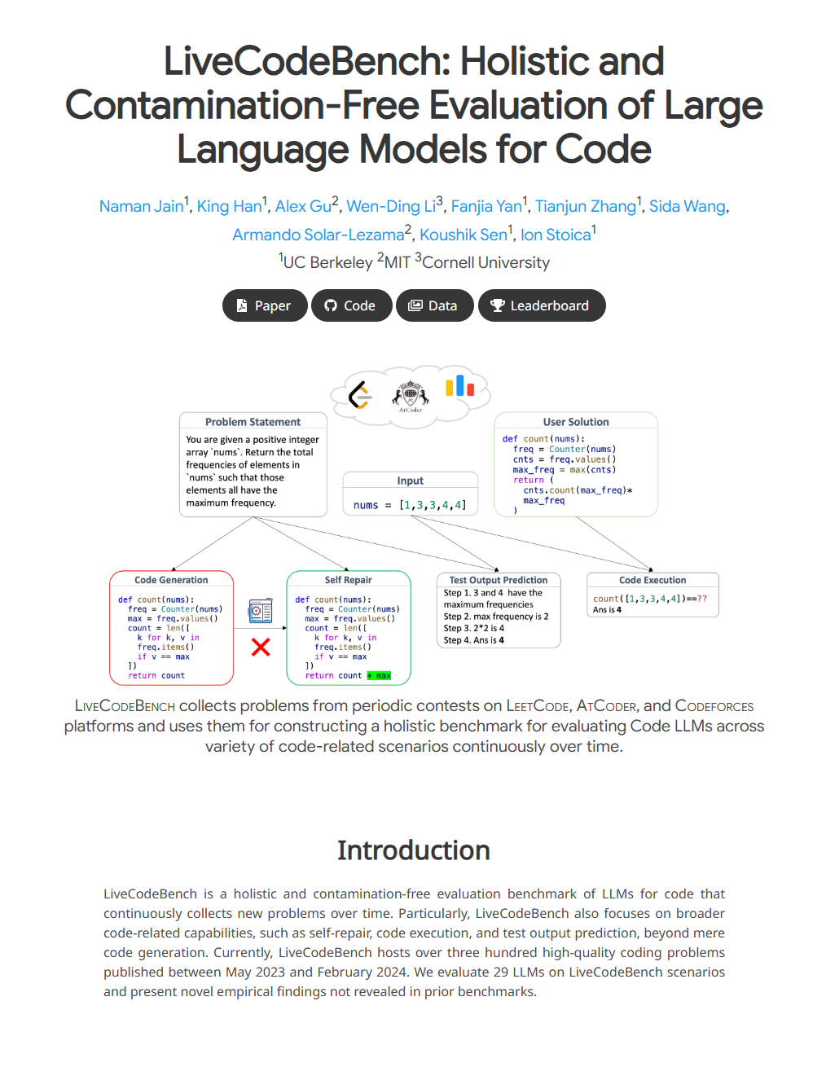
Bonus 1: Contamination (LiveCodeBench)
tag problems with release date to spot potential contamination
Maybe accidental (research papers)
Libraries change over time!

Slide 20
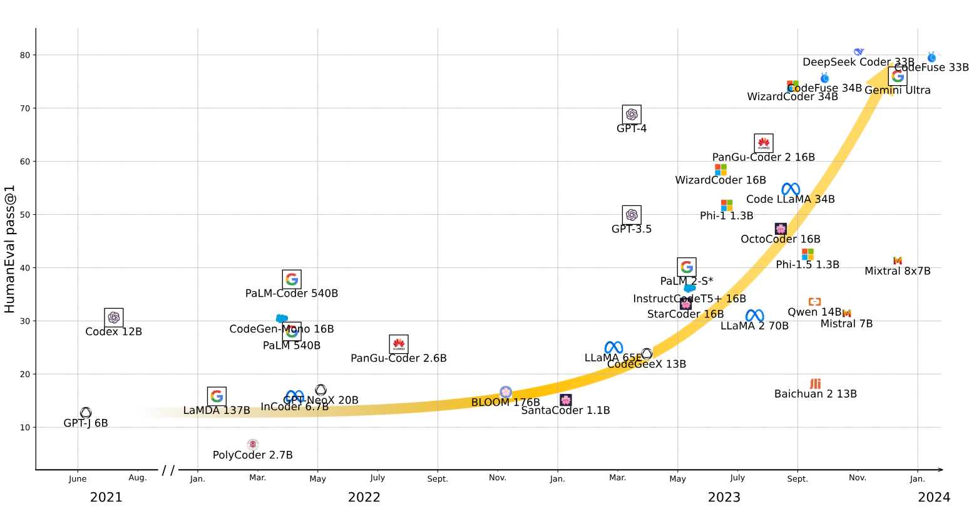
Bonus 2: Saturation
The benchmark is nearly reaching 100%, so it’s no longer useful
At what point do you call this “superhuman” performance
Happens in natural language too (Tedeschi, 2023), SWE-Bench refs
Should benchmarks stay static?

Slide 21
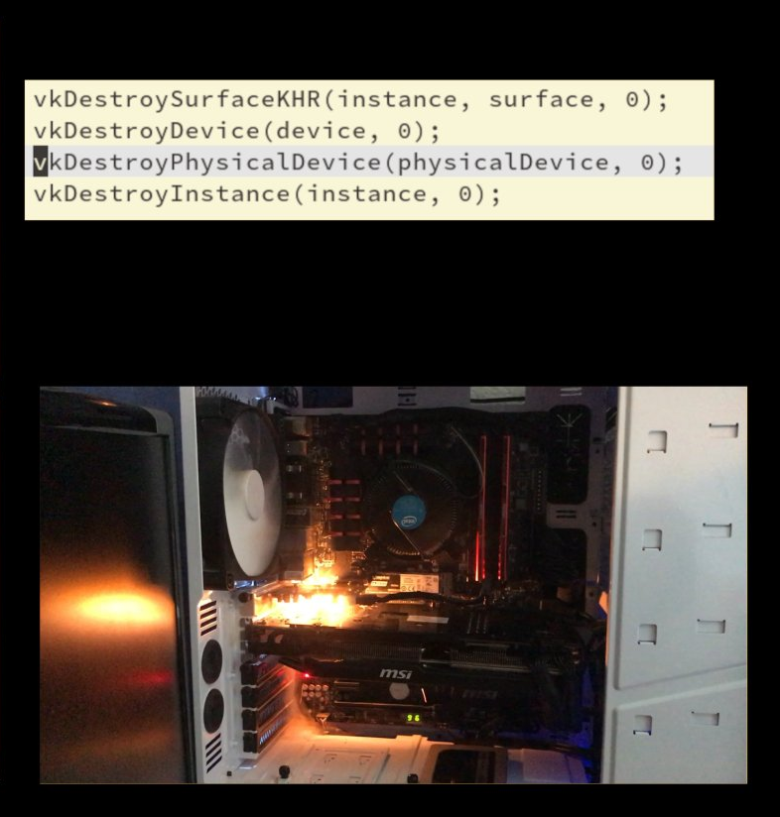
Bonus 3: Security - for who?
Sleeper models
fake libraries that get hijacked
Insecure code (when deployed)
Malicious code that steals your data
Breaks your computer??
Using language models to find and exploit security flaws
Fix security issues

Slide 22
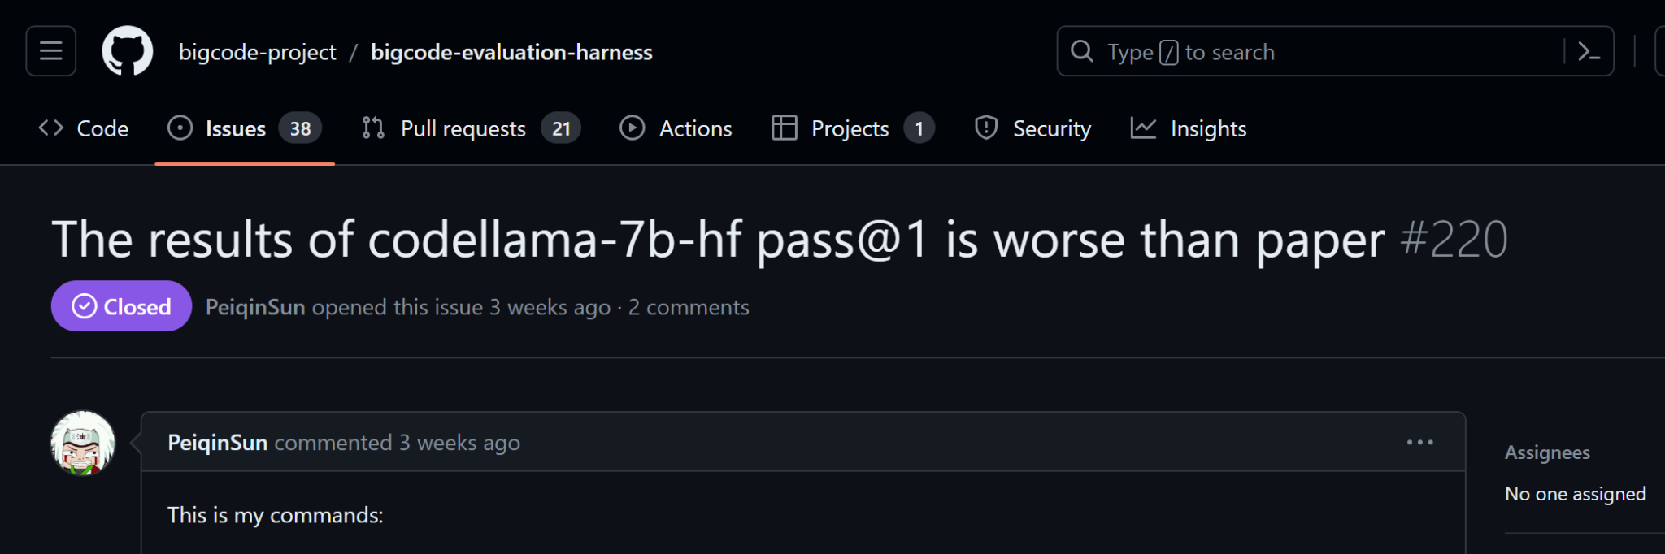
Bonus 4: reproducibility crisis
Generation parameters are not static, or disclosed
Sometimes the instruct model is used with a prompt - but not disclosed
Models behind APIs are not controllable (pre-/postprocessing, tuning)

Slide 23




Backup slides #1: LLM’s wug:

